Slide 1
Octank.com
Hybrid Applications: DevOps – CI/CD, EKS
(Elastic Kubernetes Service)
Nitu Parimi
AB3- Demo | Mar 2021

Slide 2
Stakeholders & Recap
Recap – Meeting 1
What is cloud?
Advantages of cloud computing and AWS
AWS global infrastructure
Breadth and Depth of services
Shared responsibility model and compliance
APN partner network and AWS marketplace
Stakeholders
Contact | Role
Nitu Parimi | Head, Solutions Architect (Presenter)
Nikhil Sharma | CTO
Mohit Malik | Director of Engineering - Compute and Storage
Brad Pullen | CFO
Nipun Chagari | VP of Engineering - Applications
Dustin Ellis | CISO
Tim Dormer | Shadow
Recap – Meeting 2
Workflow 1: DevOps – CI/CD automation
Workflow 2: Infrastructure modernization for hybrid cloud
Conceptual Diagram Walkthrough
Action items from meeting 2, addressed via email
Meeting 3 - Agenda
Solution Demo
Cost Estimate
Notes:
Briefly recap first meeting, attendees, and ask if there are any new attendees on the call. If there are, have them introduce themselves and get 1-2 items from them that they’d like to get out of today’s meeting.

Slide 3

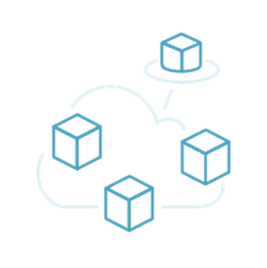
Summary of Current Challenges & Key Requirements
Workflow 1 Demo: DevOps (Continuous Integration, Continuous Delivery)
Agenda
Workflow 2 Demo: Application modernization for Hybrid Applications (using EKS)
Cost Estimate, Solution Benefits
Notes:
This is what we’ll be talking about today!

Slide 4
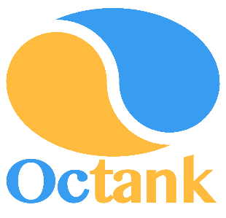

Provided by CTO after Meeting #1
200
Number of existing applications
Octank.com
Is a mid size enterprise company currently hosts applications in their private data centers, considering doing a Proof of Concept for couple of their non-business critical applications using AWS to improve developer agility
3000/8000
Number of developers and testers/ total employees
Provided by CFO after Meeting #1
$2B
“Octank.com has been a huge success, we need to start planning for infrastructure modernization for our apps as we grow. End-to-end DevOps automation will be the key as we plan our migration to cloud in hybrid cloud environment.”
- CTO
Annual Recurring Revenue (ARR)
CTO question during Meeting #2
How Lambda function in another VPC communicate with EKS cluster ?
New solutions put in place should help reduce our operational cost
- CFO
© 2021 Amazon Web Services, Inc. or its affiliates. All rights reserved |
4
Notes:
Use this time to summarize the scope of today’s meeting –
Based on feedback provided during and after meeting 1, outline the goals that we understand they want to achieve (in slide)
Also use this time to show the customer that you really understand their workload and current success – the metrics on the right, for example, were provided by the CFO via email following meeting #1.
Congratulate the customer on their success thus far with the application, but acknowledge that there are challenges they are facing and goals they would like to achieve.

Slide 5

Workflow 1 – DevOps CI/CD workflow automation
Developer Tools
“As we grow we need to start planning for infrastructure modernization for our applications. End-to-end DevOps automation will be the key as we plan our migration to cloud in hybrid cloud environment.”
- CTO
Automated DevOps workflow
Workflow 1
Create CodePipeline
Developer Commits code
CodeBuild
- creates build, test
Save in the ECR - Registry
CodeDeploy - Staging
?
CodeDeploy - Prod
Notes:
DevOps CI/CD automation:
1.
2.

Slide 6


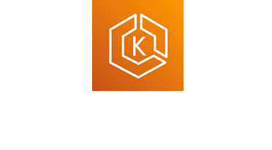
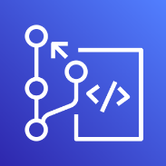
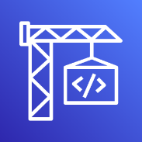
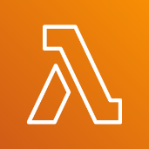




Workflow 1 Demo – DevOps – CI/CD
DevOps – Continuous Integration, Continuous delivery to automate application compile, test, build, deployment processes.
1. When code is merged into the master branch of a CodeCommit repository, a CloudWatch event triggers the execution of AWS CodePipeline.
2. AWS CodePipeline sends the new revision to AWS CodeBuild which builds a Docker container image with a build-ID.
3. AWS Code build pushes the new built Docker container image with the build-ID to and ECR Registry
4. AWS CodePipeline invokes Lambda function which leverages the kubernetes python SDK to update a kubernetes deployment object.
5. After the deployment manifest update is completed, AWS Lambda invokes the Kubernetes API to update the image in the Kubernetes application deployment
6. Kubernetes fetches the new container image from ECR and performs a rolling update of the deployment object.
Region
6
ECR Registry
3
5
1
2
4
CodeCommit
CodeBuild
Lambda function is assigned an IAM role, that has the ability to decrypt the Kubernetes clusters secrets which are stored in parameter store
CodePipeline
Parameter store
Notes:
/home/ec2-user/aws-kube-codesuite/Codesuite-Demo/
git add . && git commit -m "test CodeSuite" && git push origin master
use-case1 Result: http://a313801ace6c2408dbf55b276ccc3096-1898650892.us-west-2.elb.amazonaws.com/
use-case2 Result: RESULT http://ec2-52-33-135-86.us-west-2.compute.amazonaws.com/

Slide 7

Workflow 2 – Infrastructure modernization for Hybrid Apps
Containers
“As we grow we need to start planning for infrastructure modernization for our applications. End-to-end DevOps automation will be the key as we plan our migration to cloud in hybrid cloud environment.”
- CTO
Hybrid apps infrastructure modernization workflow
Workflow 2
Prioritize Apps migration
Connect DC and AWS
Use EC2 to invoke kubectl/eksctl
S3 for Deployment files backup
EKS: Invoke app deployment
Notes:
On this slide we’ll summarize the challenges the customer directly told us they are facing (either in meeting 1 or via email).
Application modernization – re-platform
1. EKS
2. EKS-A

Slide 8
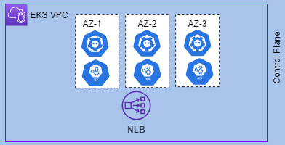



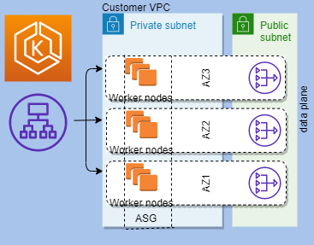






Workflow 2 – Hybrid application deployment
Infrastructure modernization using EKS- for automating container deployment on customer datacenter and on AWS. EKS cluster to use Graviton instance type and Spot pricing where applicable to further improve price saving and performance. In future further optimization can be achieved when applications are re-factored to use Micro services that can be deployed using serverless-Lambda and event driven architecture.
Region
VPC
4
3
2
Install CLI,
kubectl, eksctl.
Deployment.yaml
Application clients
1
VPN connection
CGW
VPG
Corporate DC
AWS Direct Connect

Slide 9
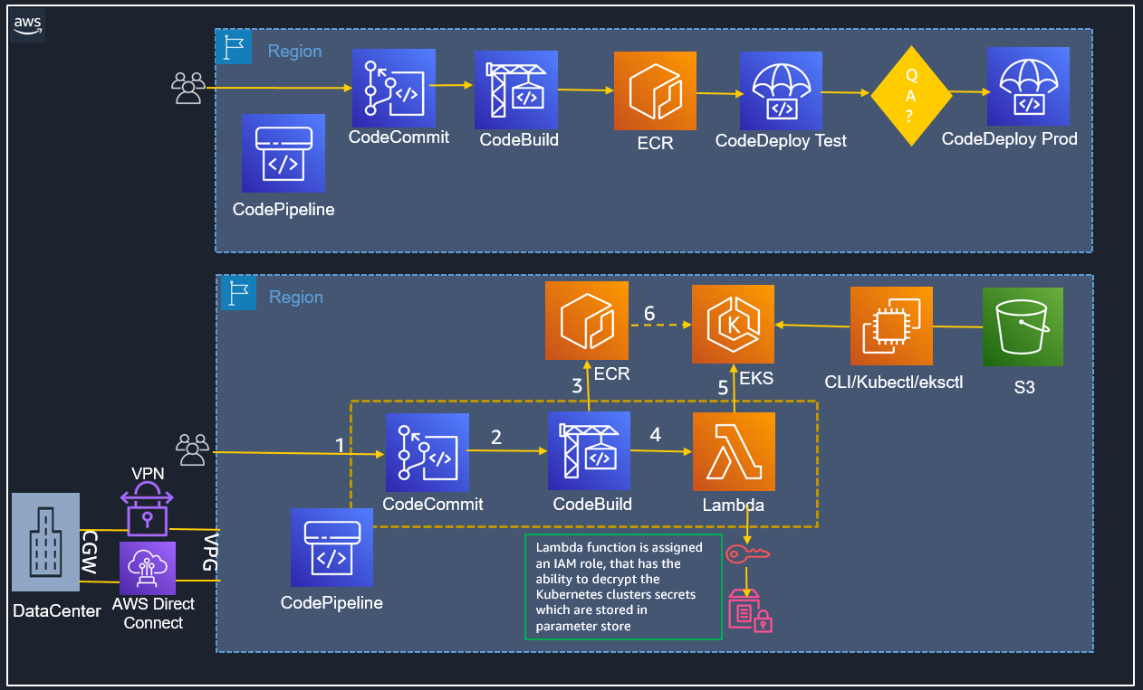
End- End Solution
Infrastructure modernization using EKS- for automating container deployment on customer datacenter and on AWS. EKS cluster to use Graviton-2 Arm processor based instances that offer 40% better price/performance and Spot| RI instances where applicable for additional cost savings. In future further optimization can be achieved when applications are re-factored to use microservices that can be deployed using serverless-Lambda and event driven architecture.
DevOps CI/CD workflow automation - compile, test, build, and deploy applications to production steps will be automated using AWS DevOps services. This solution works well with hybrid environments as well as cloud native.

Slide 10

Snap Inc. is a camera and social media company empowering people to express themselves, live in the moment, learn about the world, and have fun together.
“Snap uses Kubernetes to solve the problems of managing a large set of services, and EKS is helping them to run over 2 million transactions per second. Through EKS and ECR, Snap has realized a 77% reduction in developer effort for launching new microservices.”
Karl D’Adamo – Sr. Director of Engineering, Snap
Deep dive in Snap Inc. 2019 re:Invent presentation “Amazon EKS under the hood”

Slide 11
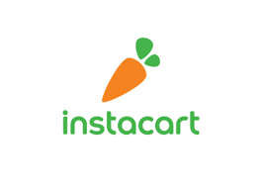

Instacart - Instacart uses AWS CodeDeploy to automate deployments for all of its front-end and back-end services. Using AWS CodeDeploy has enabled Instacart’s developers to focus on their product and worry less about deployment operations.
Lululemon Athletica - uses a variety of AWS services to engineer a fully automated, continuous integration and delivery system. Lululemon deploys artifacts distributed via Amazon S3 using AWS CodePipeline. From this stage, the artifacts are deployed to AWS Elastic Beanstalk.

Slide 12
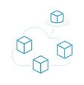
Summary of Current Challenges & Key Requirements
Demo Workflow 1 – Continuous Integration Continuous Delivery (CI/CD)
DevOps-CI/CD automation, Infrastructure modernization
Using Code Pipeline, Code Build, Code Deploy, AWS EKS, Direct Connect, S3.
Steps covered today:
Setup Live PoC for Octank.com in AWS Environment
Cost Estimate
Demo Workflow 2 – Hybrid Applications (using EKS)
Solution Benefits, Cost Estimate, Next Steps

Slide 13
Cost Estimate - Assumptions
General Assumptions:
Prices are calculated per month = 30 days X 24 X per hour rate
Workflow 1 Assumptions – DevOps
EKS Nodes in the cluster are using two m6g.large graviton instance
CodePipeline - Only one active code pipeline/month
CodeBuild - Average 100 builds per app/per month
Lambda usage still within free tier limits
ECR Registry stored 10 images per application in a month
Workflow 2 Assumptions – Infrastructure modernization
EKS Nodes in the managed cluster are using m6.g graviton instance or spot m5.xlarge
Code Deploy within AWS no cost, You pay $0.02 per on-premises instance
S3 storage will be under 5GB first year, qualifying for free tier.
VPN 1000GB data transfer out
Direct Connect –1000GB data transfer out. Data transfer cost + port hours(dedicated/hosted)
Notes:
S3 Archive Pricing – https://aws.amazon.com/s3/pricing/
Code Commit pricing - https://aws.amazon.com/codecommit/pricing/
CodePipeline – https://aws.amazon.com/codepipeline/pricing/
CodeBuild - https://aws.amazon.com/codebuild/pricing/
Parameter Store: https://aws.amazon.com/systems-manager/pricing/
EKS: pricing: https://aws.amazon.com/eks/pricing/
Graviton M6g.large https://aws.amazon.com/ec2/pricing/on-demand/
ECR pricing: https://aws.amazon.com/ecr/pricing/
CodeDeploy Pricing : https://aws.amazon.com/codedeploy/pricing/
Spot Pricing: https://aws.amazon.com/ec2/spot/pricing/
AWS VPN pricing: https://aws.amazon.com/vpn/pricing/
Direct Connect: https://aws.amazon.com/directconnect/pricing/
VPN Vs Direct Connect
$0.09 per GB data transfer out +$0.05 per VPN Connection Hour $0.02 per GB data transfer out + Port hour fees(0.30+/ for 1G)

Slide 14
Cost Estimate
* Free Tier Eligible and/or Free Trial
WORKFLOW 1 – CI/CD - DevOps
WORKFLOW 2 – EKS Graviton
Service | Price (monthly)
CodeCommit | $8
CodePipeline | $1
CodeBuild | $2
Parameter Store | $0.05
EKS service | $72
Graviton m6.g – 2 instances | $82.94
Ec2 t3.medium | $29.95
ECS Registry | $1
Lambda | FREE
Total Monthly (Estimate) | $197
Service | Price (monthly)
CodeDeploy | FREE
Graviton m6.g | $41.47
Spot m5.xlarge | $28.87
Ec2 t3.medium | $29.95
ECS Registry | $1
S3 | FREE
VPN – 1000GB data out | $125.91
Direct Connect – 1000GB data | $235
Total Monthly (Estimate) | $457
Cost Estimate displayed is only an estimate of your AWS fees using input assumptions and doesn't include any taxes that might apply. Your actual fees depend on a variety of factors, including your actual usage of AWS services.
Notes:
Service pricing references:Build minutes = 100 builds * 5 minutes = 500 build minutes
Code Commit pricing: https://aws.amazon.com/codecommit/pricing/
First 5 users are free, $1.00 per month 1500 developers - 200 - one application 8 developers
Codepipeline – https://aws.amazon.com/codepipeline/pricing/
1 Application active (with at least one code change/month)
CodeBuild - https://aws.amazon.com/codebuild/pricing/
If you execute 100 builds in one month using build.general1.small where each build runs for 5 minutes, then your charges would be calculated as follows:
Monthly build charges
Build minutes – Free tier build minutes = Monthly billable build minutes = 500 – 100 = 400 build minutes
Monthly build charges = 400 build minutes * $0.005 = $2
Parameter Store: https://aws.amazon.com/systems-manager/pricing/
Parameter type Pricing - Standard ThroughputPricing - Higher Throughput
Standard No additional charge $0.05 per 10,000 Parameter Store API interactions
Advanced $0.05 per 10,000 Parameter Store API interactions $0.05 per 10,000 Parameter Store API interactions
For example, if a Get request returns ten parameters, that counts as ten Parameter Store API interactions.
EKS: pricing: https://aws.amazon.com/eks/pricing/
You pay $0.10 per hour for each Amazon EKS cluster that you create.
Graviton M5.large vs M6g.large
m5.large 2 $0.096 per Hour
M6g.large 2 vCPU and 8GB memory
https://aws.amazon.com/ec2/pricing/on-demand/
t3.medium 2 ECU:Variable 4 GiB EBS Only $0.0416 per Hour
ECR pricing: https://aws.amazon.com/ecr/pricing/
Storage is $0.10 per GB-month for data stored in private or public repositories.
Typical container image size 200MB to 980MB
Lambda : https://aws.amazon.com/lambda/pricing/
The AWS Lambda free usage tier includes 1M free requests per month and 400,000 GB-seconds of compute time per month.
If free limits exhausted: Price calculated based on #of requests, duration and memory
If you allocated 512MB of memory to your function, executed it 3 million times in one month, and it ran for 1 second each time, your charges would be calculated as follows:
Monthly compute charges
The monthly compute price is $0.00001667 per GB-s and the free tier provides 400,000 GB-s.
Total compute (seconds) = 3M * (1s) = 3,000,000 seconds
Total compute (GB-s) = 3,000,000 * 512MB/1024 = 1,500,000 GB-s
Total compute – Free tier compute = Monthly billable compute GB- s
1,500,000 GB-s – 400,000 free tier GB-s = 1,100,000 GB-s
Monthly compute charges = 1,100,000 * $0.00001667 = $18.34
Monthly request charges
The monthly request price is $0.20 per 1 million requests and the free tier provides 1M requests per month.
Total requests – Free tier requests = Monthly billable requests
3M requests – 1M free tier requests = 2M Monthly billable requests
Monthly request charges = 2M * $0.2/M = $0.40
Total monthly charges
Total charges = Compute charges + Request charges = $18.34 + $0.40 = $18.74 per month
CodeDeploy Pricing : https://aws.amazon.com/codedeploy/pricing/
For CodeDeploy on EC2, Lambda, ECS: There is no additional charge for code deployments to Amazon EC2, AWS Lambda or Amazon ECS through AWS CodeDeploy.
For CodeDeploy On-Premises: You pay $0.02 per on-premises instance update using AWS CodeDeploy
S3 https://aws.amazon.com/s3/pricing/
AWS Free Tier, Upon sign-up, new AWS customers receive 5GB of Amazon S3 storage in the S3 Standard storage class; 20,000 GET Requests; 2,000 PUT, COPY, POST, or LIST Requests; and 15GB of Data Transfer Out each month for one year.
Spot Pricing: https://aws.amazon.com/ec2/spot/pricing/
m5.xlarge $0.0401 per Hour - Linux $0.2239 per Hour-windows
AWS VPN pricing: https://aws.amazon.com/vpn/pricing/
Pricing example 1 without Accelerated Site-to-Site VPN
You create an AWS Site-to-Site VPN connection to your Amazon VPC in US East (Ohio). The connection is active for 30 days, 24 hours a day. 1,000 GB are transferred in and 500 GB are transferred out through that connection.
AWS Site-to-Site VPN connection fee: You will be charged for your AWS Site-to-Site VPN connection on an hourly basis, for each hour the connection is active. For this AWS Region, the rate is $0.05 per hour.
Data transfer out fee: Your first GB is free, you will be charged for 499 GB at $0.09 per GB. This will result in a charge of $44.91.
This will result in a total charge of $80.91.
Pricing example 2 with Accelerated Site-to Site VPN
You create an Accelerated Site-to-Site VPN connection from your Amazon VPC in US East (Ohio) to a remote site located in Europe. The connection is active for 30 days, 24 hours a day. 1,000 GB are transferred in and 500 GB are transferred out through that connection.
Accelerated Site-to-Site VPN connection fee: You will be charged for your AWS Site-to-Site VPN connection on an hourly basis, for each hour the connection is active. For this AWS Region, the rate is $0.05 per hour. This will result in a charge of $36.
Data transfer out fee: Your first GB is free, you will be charged for 499 GB at $0.09 per GB. This will result in a charge of $44.91.
AWS Global Accelerator hourly fee: You will be charged for the two Global Accelerators used for your VPN connection on an hourly basis, for each hour the connection is active. The hourly rate is $0.025 per Global Accelerator, totaling $0.05 per hour. This will result in a charge of $36.
Accelerated Site-to-Site VPN DT-Premium fee: You will be charged DT Premium for the dominant direction of data transfer, which in this case is the 1,000 GB data in. For the monthly traffic of 1,000 GB between the regions in America and Europe, you are charged $15 at $0.015/GB.
This will result in a total charge of $131.91.
Direct Connect: https://aws.amazon.com/directconnect/pricing/
Dedicated
Capacity Port-Hour rate (All AWS Direct Connect locations except in Japan) Port-hour rate in Japan
1G $0.30/hour $0.285/hour
10G $2.25/hour $2.142/hour 100G $22.50/hour $22.50/hour
Hosted
Data transfer IN is $0.00 per GB in all locations.
Data Transfer OUT pricing is dependent on the source AWS Region and AWS Direct Connect location
United States $0.0200(USA) $0.0200(Canada) $0.0282(EU) $0.0900(APAC)
https://www.coresite.com/blog/vpn-or-direct-connect-aws-compared
AWS Direct Connect is a great option for businesses for secure, ultra-low latency connectivity into AWS. While provisioning AWS Direct Connect can sometimes be more involved, it is worth it once the connectivity is established, because of the ease of predictable network performance and 60% cost savings.
VPN Vs Direct Connect
$0.09 per GB data transfer out +$0.05 per VPN Connection Hour $0.02 per GB data transfer out + Port hour fees(0.30+/ for 1G)

Slide 15
Appendix

Slide 16
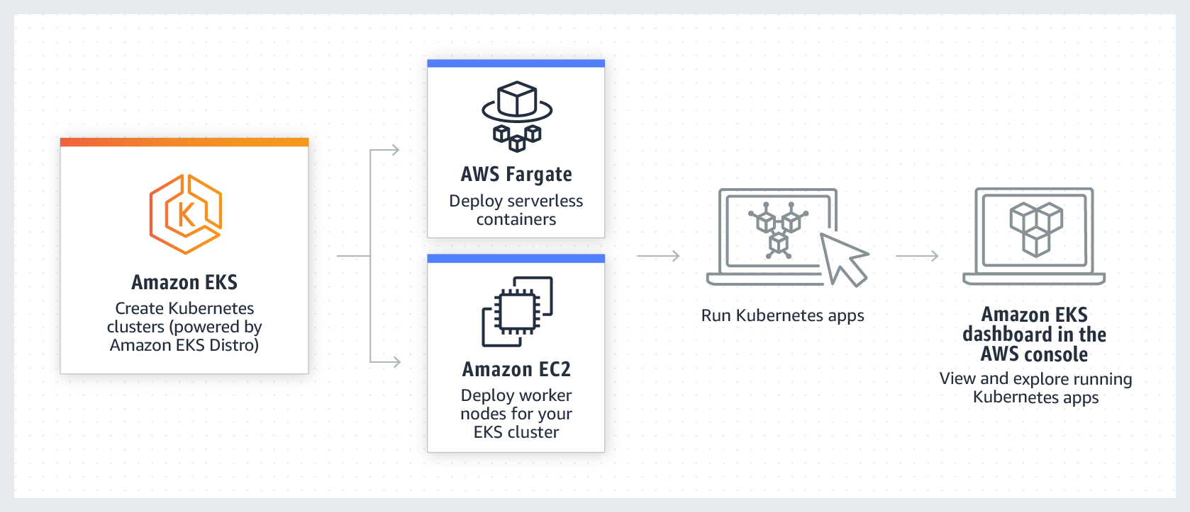
Amazon EKS
Notes:
https://aws.amazon.com/eks/eks-anywhere/

Slide 17
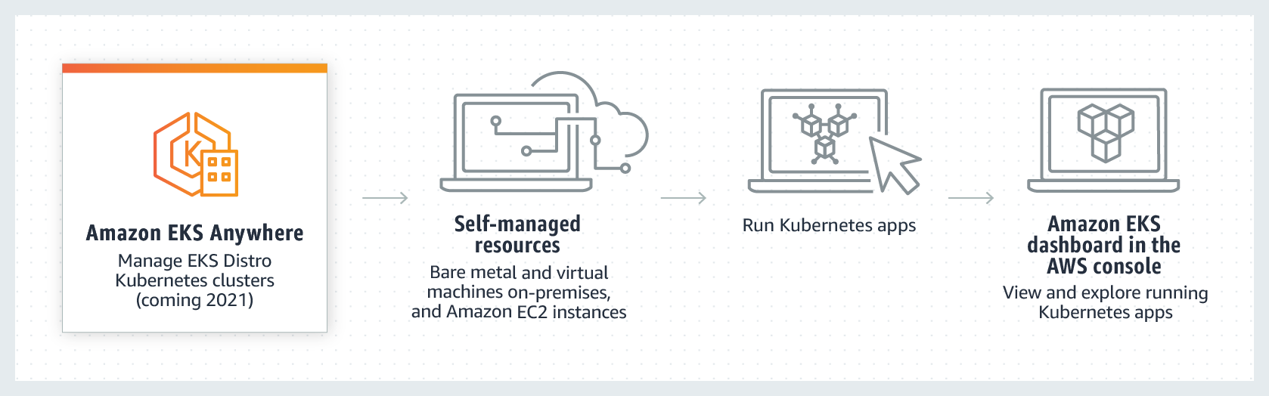
Amazon EKS - Anywhere
Notes:
https://aws.amazon.com/eks/eks-anywhere/faqs/

Slide 18
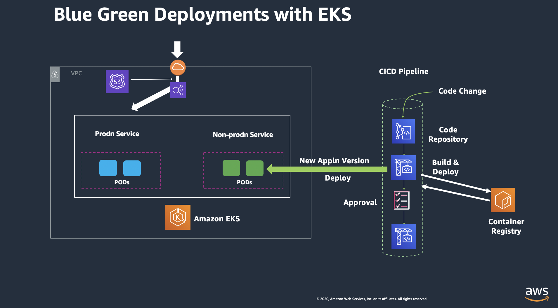
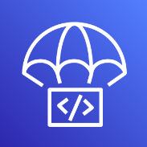
AWS DevOps services
Software Release Workflows
AWS CodePipeline
AWS CodePipeline is a continuous integration and continuous delivery service for fast and reliable application and infrastructure updates. CodePipeline builds, tests, and deploys your code every time there is a code change, based on the release process models you define. This enables you to rapidly and reliably deliver features and updates.
Build and Test Code
AWS CodeBuild
AWS CodeBuild is a fully managed build service that compiles source code, runs tests, and produces software packages that are ready to deploy. With CodeBuild, you don’t need to provision, manage, and scale your own build servers. CodeBuild scales continuously and processes multiple builds concurrently, so your builds are not left waiting in a queue.
Deployment Automation
AWS CodeDeploy
AWS CodeDeploy automates code deployments to any instance, including Amazon EC2 instances and on-premises servers. AWS CodeDeploy makes it easier for you to rapidly release new features, helps you avoid downtime during application deployment, and handles the complexity of updating your applications.
Supports in-place and blue-green deployments.
For more on AWS DevOps
Notes:
https://blog.container-solutions.com/kubernetes-deployment-strategies
recreate: terminate the old version and release the new one
spec:
replicas: 3
strategy:
type: Recreate
ramped: release a new version on a rolling update fashion, one after the other - type: RollingUpdate
blue/green: release a new version alongside the old version then switch traffic - type: NodePort
canary: release a new version to a subset of users, then proceed to a full rollout
Truncated deployment manifest version A:
spec:
replicas: 3
Truncated deployment manifest version B, note that we only start one replica of the application:
spec:
replicas: 1
a/b testing: release a new version to a subset of users in a precise way (HTTP headers, cookie, weight, etc.). A/B testing is really a technique for making business decisions based on statistics but we will briefly describe the process. This doesn’t come out of the box with Kubernetes
A/B testing - best for feature testing on a subset of users
route:
- tags:
version: v1.0.0
weight: 90
- tags:
version: v2.0.0
weight: 10

Slide 19
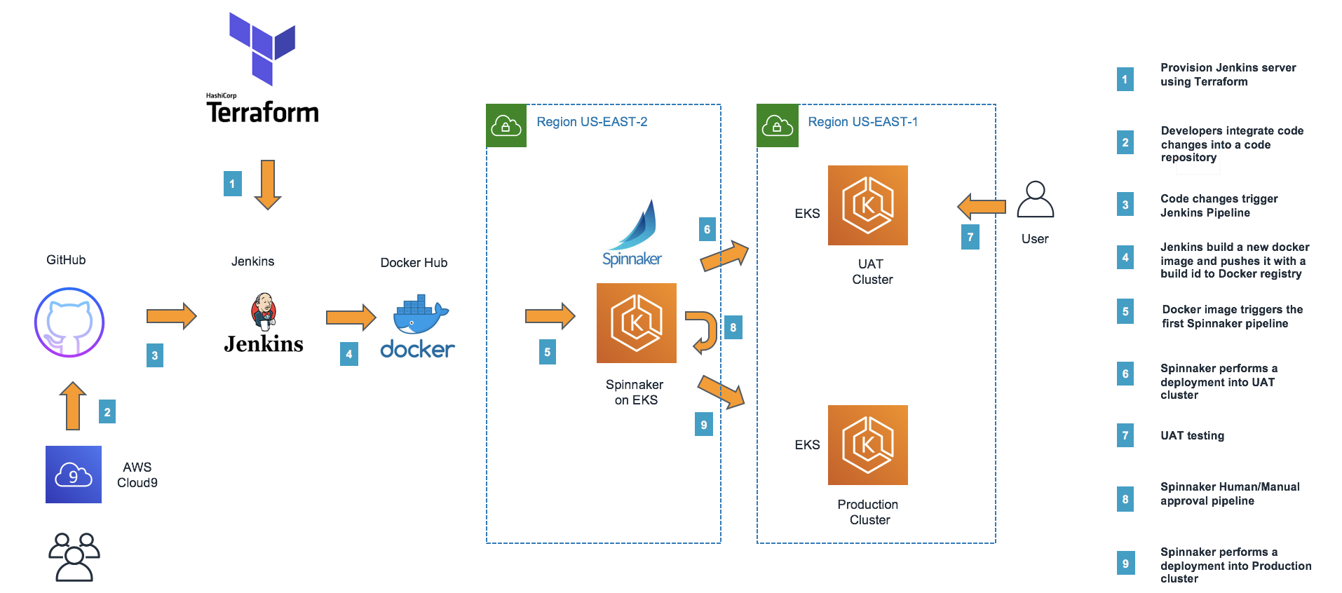
CI/CD using open source and EKS
Notes:
https://blog.container-solutions.com/kubernetes-deployment-strategies
recreate: terminate the old version and release the new one
spec:
replicas: 3
strategy:
type: Recreate
ramped: release a new version on a rolling update fashion, one after the other - type: RollingUpdate
blue/green: release a new version alongside the old version then switch traffic - type: NodePort
canary: release a new version to a subset of users, then proceed to a full rollout
Truncated deployment manifest version A:
spec:
replicas: 3
Truncated deployment manifest version B, note that we only start one replica of the application:
spec:
replicas: 1
a/b testing: release a new version to a subset of users in a precise way (HTTP headers, cookie, weight, etc.). A/B testing is really a technique for making business decisions based on statistics but we will briefly describe the process. This doesn’t come out of the box with Kubernetes
A/B testing - best for feature testing on a subset of users
route:
- tags:
version: v1.0.0
weight: 90
- tags:
version: v2.0.0
weight: 10

Slide 20
What Applications to move first?
Batch processing solutions are a great place to start
Everything does not have to go at once, but make sure “connected” workloads stay together
Storage is another great place to leverage the cloud
If you have your data replicating to the cloud, this gives you the ability to look at how you deliver reporting
Disaster Recovery (DR) is a very common first step in moving into the cloud
Software development, test, QA good to move
Collaboration Applications good for move
Big data and Analytics good for move
Applications not using VM’s and ERP/ other system of record are not good first movers
Performance, HA requirements, Sensitive data and compliance needs – not good first movers
Selection Process:
Business value of the app – pick less critical
Pick common pattern app vs app being run unique-way
Teams responsible for development, deployment and operations of the application.
Number, type and scope of dependencies(focus on lowest dependencies, loosely coupled)
Re-factoring effort
Compliance, licensing and no-multi tenant requirement
Availability, Reliability and latency of the application
Notes:
Reference: https://blog.mycloudit.com/what-should-you-move-to-the-cloud-first
App Name | Source code Location | Technologies | Deployment Procedure | Other Req | Dependencies | System resource requirement
| | | | | |
Mktg website | Corp Repo |Angular-frontend| Automated | Legal must validate content | Caching service| 5 CPU cores, 8GB RAM
| | | | | |
Back office | Corp Repo | Java backend | Automated | N/A | SQL DB | 4 CPU cores, 4GB RAM
Angular frontend|

Slide 21
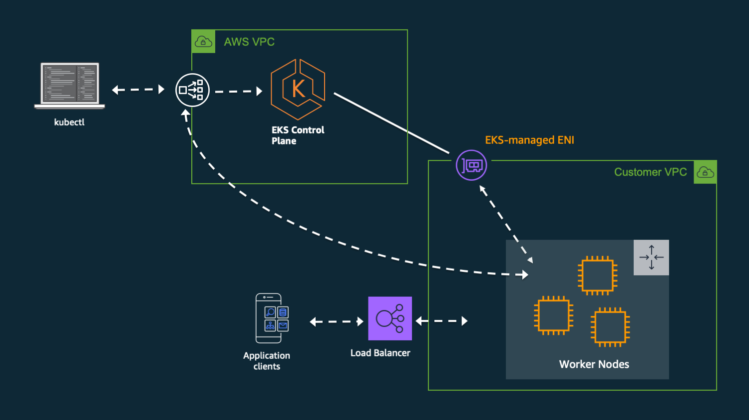
References
Networking:
https://aws.amazon.com/blogs/containers/de-mystifying-cluster-networking-for-amazon-eks-worker-nodes/
https://www.fairwinds.com/blog/how-to-deploy-multi-tiered-web-application-with-kubernetes
https://docs.aws.amazon.com/eks/latest/userguide/getting-started-eksctl.html
Deploy Dashboard, Deployment methods:
https://www.youtube.com/watch?v=CICS57XbS9A
https://www.cncf.io/wp-content/uploads/2020/08/CNCF-Presentation-Template-K8s-Deployment.pdf
EKS Service Limits
https://docs.aws.amazon.com/eks/latest/userguide/service-quotas.html
https://aws.amazon.com/blogs/containers/operating-a-multi-regional-stateless-application-using-amazon-eks/
Sample Yaml files and Diagrams:
https://eksctl.io/
https://github.com/weaveworks/eksctl/blob/main/examples/04-existing-vpc.yaml
https://blogs.tensult.com/2019/08/14/guide-to-setup-kubernetes-in-aws-eks-using-terraform-and-deploy-sample-applications/
https://aws.amazon.com/quickstart/architecture/amazon-eks/
https://docs.aws.amazon.com/eks/latest/userguide/eks-networking.html

Slide 22


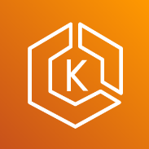
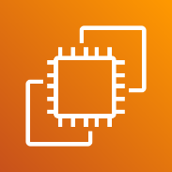

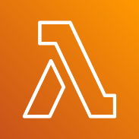
Region
QA ?
CodeCommit
CodeDeploy Prod
CodeBuild
ECR
CodeDeploy Test
CodePipeline
Region
6
ECR
EKS
CLI/Kubectl/eksctl
3
5
S3
1
2
4
VPN
CodeCommit
CodeBuild
Lambda
CGW
VPG
Lambda function is assigned an IAM role, that has the ability to decrypt the Kubernetes clusters secrets which are stored in parameter store
DataCenter
AWS Direct Connect
CodePipeline

Slide 23
SA flywheel
Selection
Onboarding
Use
Expansion
Internal Handoff
Business Orchestration
Pre Boarding
Internal Handoff
Deliver Value
Review Results
Customer Handoff
Technical Kickoff
Monitor Respond
Renew Expand
Commit
Sales
Sales
Dotted line represents less active role
SA + on demand Specialist
SA + on demand Specialist
ProServ, Partner
TAM(support)
Customer Success
Marketing
Notes:
On this slide we’ll summarize the challenges the customer directly told us they are facing (either in meeting 1 or via email).
Application modernization – re-platform
1. EKS
2. EKS-A

